Slide 1

Exploratory Data Analysis of AMCAT Data
by Gadella Rajaneesh

Slide 2

About me
Background
B-Tech in Computer Science and Technology
Why you want to learn Data Science
Because it enables me to apply my analytical thinking and problem-solving skills to the extraction of insights from data. Those insights helps in making well-informed decisions and producing significant solutions across a range of industries. In the present world, many organizations, businesses, big firms rely on the DATA to compete in the market. Along with the Data Science, I also want to learn and develop skills in emerging doamins like Machine Learning, Deep Learning and Artificial Intelligence.
Work experience
Internship and Tranining @ Learn and Build
Machine Learning Intern (Online)
• Mastered data pre-processing, model building, and evaluation techniques, ensuring robust analysis and insightful conclusions.
• Engaged in collaborative real-world projects, refining problem-solving skills and driving innovation in artificial intelligence.
LinkedIn Profile
Github Profile

Slide 3
Business Problem
AMCAT, known as Aspiring Minds Computer Adaptive Test is an AI-based computer adaptive test which evaluates job applicants on critical areas like communication skills, logical reasoning, quantitative skills, and job-specific domain skills thereby helping recruiters identify the suitability of a candidate for different job roles.
Objective of the Project
This analysis aims to gain insights and understanding from the provided dataset, particularly focusing on the relationship between various features and the target variable, which is Salary.
This analysis breaks down the objectives into two:
- Data Cleaning and Data Transformation
- Univariate and Bivariate analysis of variables
- Answers and conclusions to relevant hypothesis or questions.

Slide 4
Summary of the Data
Here the data we are working on is the study of Employment Outcome of Engineering Graduates such as his/her Salary, Job Title, Job Location along the scores in these areas - cognitive skills, technical skills and personality skills.
The dataset contains around 40 independent variables and 4000 data points(4000 persons). The independent variables are both continuous and categorical in nature. The dataset was released by Aspiring Minds from the Aspiring Mind Employment Outcome 2015 (AMEO).
Independent Variables:
Technical Skills: Scores in 'ComputerProgramming', 'ElectronicsAndSemicon', 'ComputerScience', 'MechanicalEngg', 'ElectricalEngg', 'TelecomEngg', 'CivilEngg’.
Personality Traits: Scores in 'conscientiousness', 'agreeableness', 'extraversion', 'nueroticism', 'openess_to_experience’
Thinking Skills: Scores in 'English', 'Logical', 'Quant’
Personal Information : ID, Gender, DOB, academic records, City, Designation, Date of Joining and Date of Leaving.
Dependent Varaibles:
Salary

Slide 5
Exploratory Data Analysis:
Data Cleaning Steps and
Data Manipulation Steps
As the first column has same value i.e., train for the entire data-set. so we can say that it is unnecessary for the EDA and we can remove that.
Assuming these respondents left their companies by the time of the survey's conclusion in 2015, we'll replace the 'present' value in the column `Date of Leaving (DOL)` with `2015-12-31`.
Convert the data types of the `Date of Joining (DOJ)` and `Date of Leaving (DOL)` and `Date of Birth (DOB)` columns to datetime format for consistency and ease of analysis.
Here we say that `40` out of `3998` were left the company before joining the company i.e., there were 40 DOL values that were earlier than DOJ. So these values might to be typos, then we drop those rows.

Slide 6
5. Converting every entries in the `Gender` column more descriptive.
6. Validating the results that they were in percentage(s) and not in CollegeGPA or otherwise.
7. Fixing the inconsistencies in the columns `JobCity`, `Designation`, `Specialization`, `10board`, `12board`.
8. Extracting the year from `12graduation` and inserting a column `12graduation_year` for ease of analysis
9. Replacing the outlier in `GraduationYear` with the median value.
After Fixing Improper Columns along with its Irrelevant Values AND Fixing the improper data types of each column.
Cleaned Data Shape: (3943, 39)

Slide 7
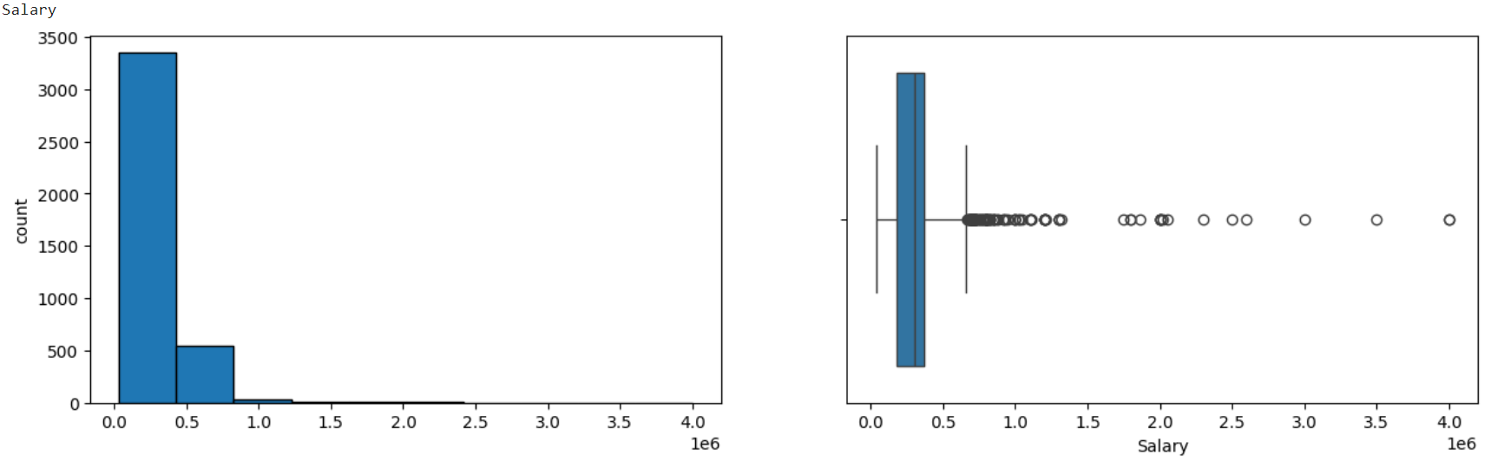

c) Univariate Analysis – Non Visual and Visual i. For Numerical Columns
Salary
The summary plot of the salary data indicates considerable variation among the salary values. The histogram reveals a significant positive skewness, suggesting that the distribution of salaries is not symmetrical and is skewed towards higher values.
Box plots further emphasize a concentration of high salaries, indicating the presence of outliers at the upper end of the salary distribution. These outliers represent individuals with exceptionally high salaries compared to the rest of the dataset.

Slide 8
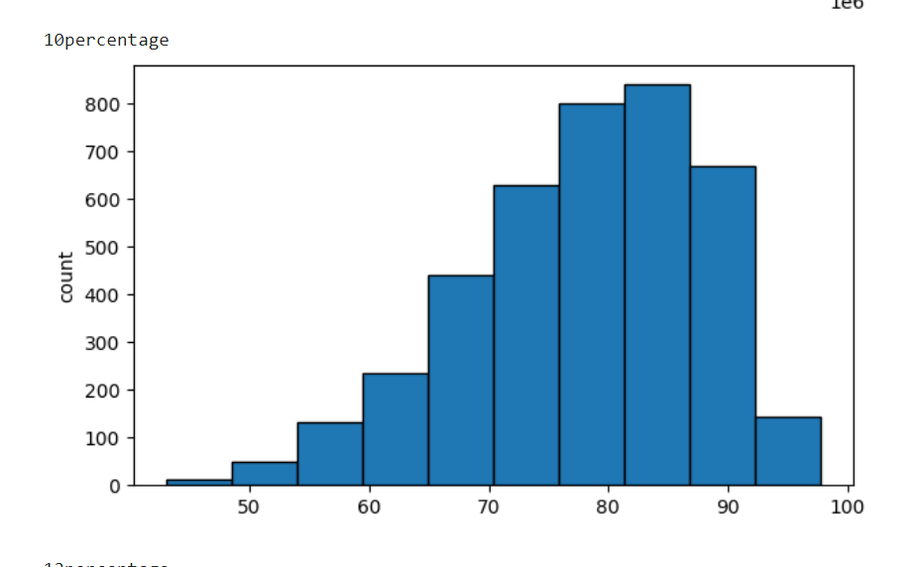
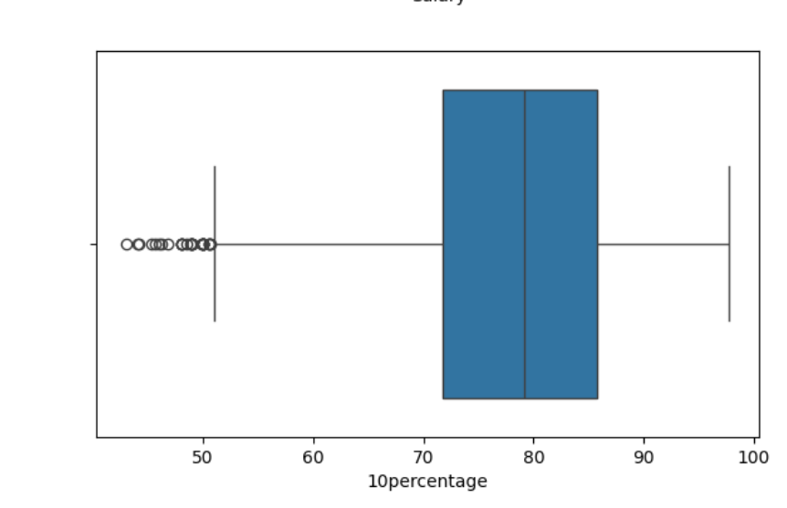
10percentage
The summary plot of the 10th percentage data shows that around half of the students achieved scores of approximately 80% or lower. The histogram illustrates a scarcity of students with low percentages, with the majority falling within the 75% to 90% range, peaking at around 78%.
Extreme outliers are evident from the box plot, indicating some irregularities in the distribution of the data. These outliers represent individuals with exceptionally high or low 10th percentage scores compared to the rest of the dataset.
While many students scored well, some outliers achieved much higher results.

Slide 9
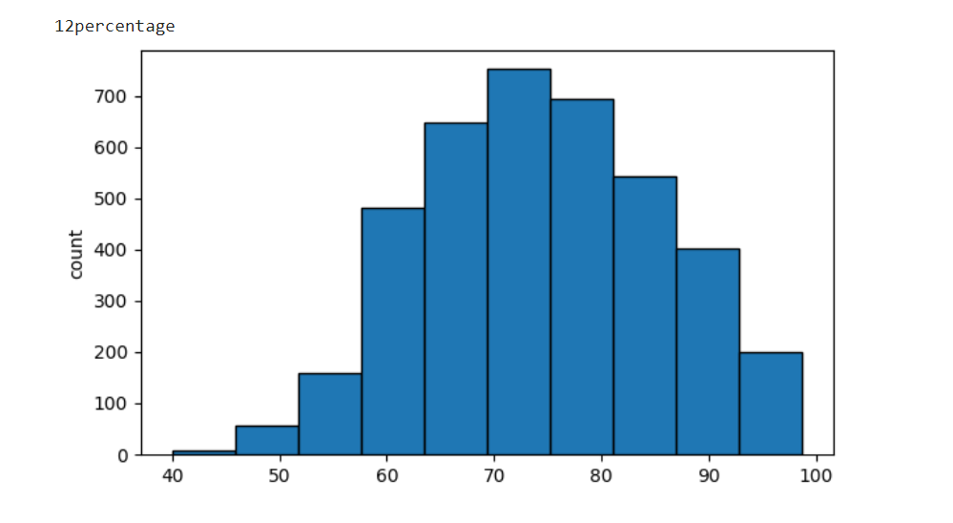
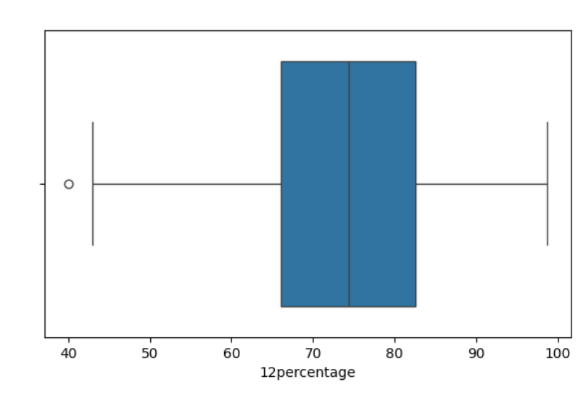
12percentage
Upon analyzing the dataset, it is evident that approximately half of the students scored around 78% or lower in their 12th-grade examinations. This indicates that a significant portion of students achieved scores below the 80% mark, highlighting a scarcity of low scores in the dataset.
Examining the histogram, it is observed that the majority of students scored between 69% and 84%, with the highest frequency occurring around the 70% mark. However, an outlier with an exceptionally low score is noticeable, suggesting an anomaly in the data distribution.
The majority (between 69% and 84%) scored within a specific range.much more.
Students with very low scores are scarce.

Slide 10
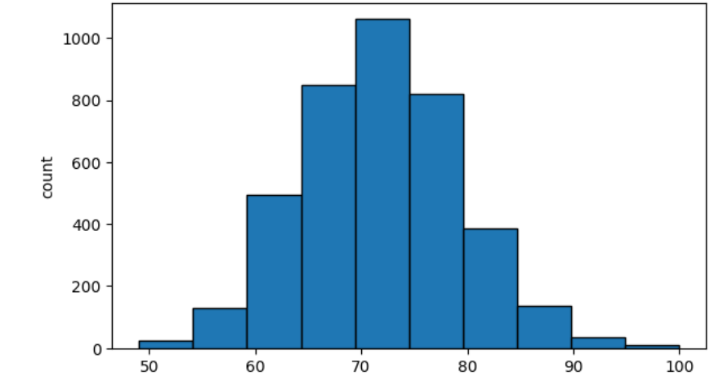
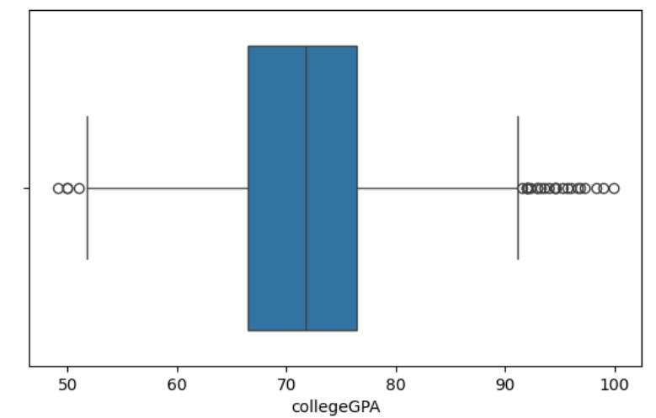
CollegeGPA
Examining the histogram, it is observed that most students had GPAs between 63% and 78%, with the highest frequency occurring around the 70% mark. This suggests that the majority of students achieved GPAs within a relatively narrow range. Additionally, the average GPA is calculated to be 74%.
Both low and high extreme values are apparent in the dataset, as indicated by the box plot. This variability in GPAs suggests differences in academic performance among students, with some achieving exceptionally high or low GPAs compared to the rest of the dataset.
Around 75% of students scored 80% or lower on their GPA.

Slide 11
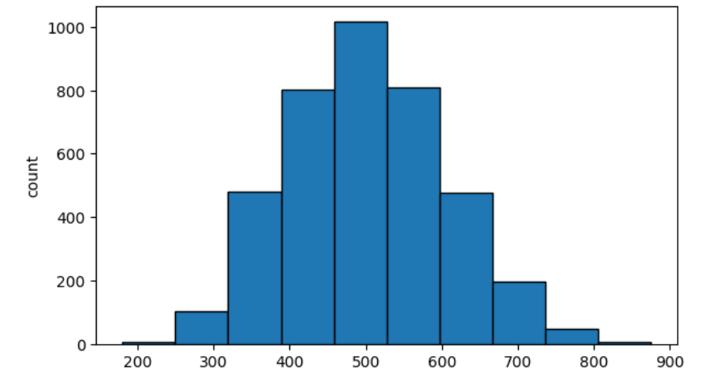
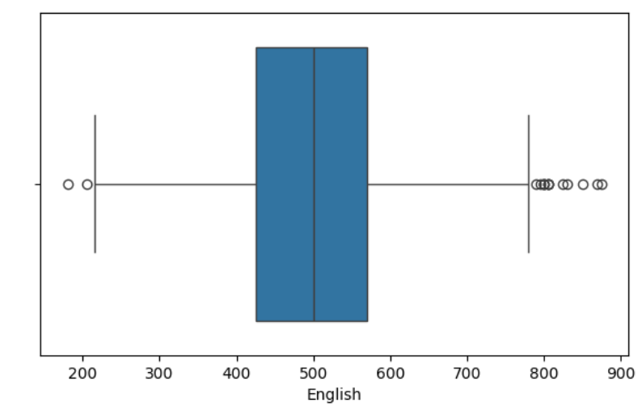
English
min: 180 max: 875 mean: 501.79 median: 500.0 25%: 425.0 50%: 500.0 75%: 570.0 skew: 0.2 kurtosis: -0.25.
Average Performance:
The average score was 502.
Outliers Present:
Both very low and very high scores were present, as shown by the box plot.

Slide 12
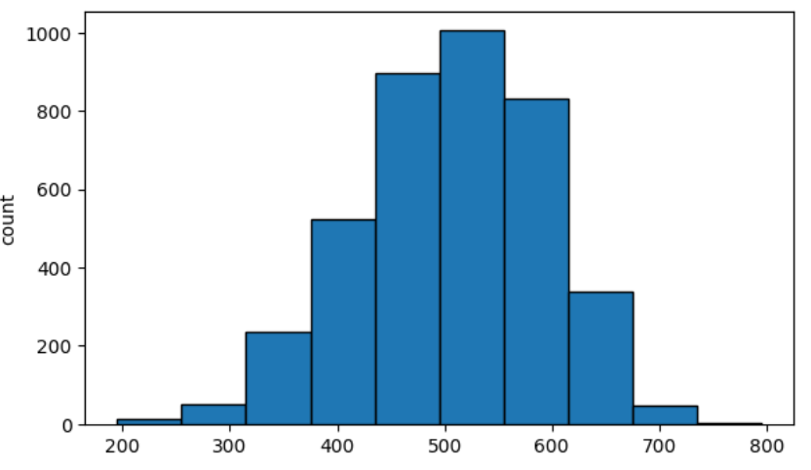
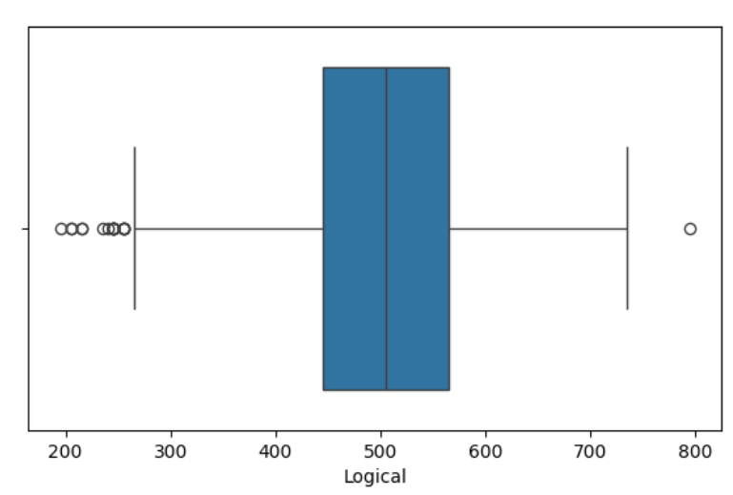
Logical
min: 195 max: 795 mean: 501.61 median: 505.0 25%: 445.0 50%: 505.0 75%: 565.0 skew: -0.22 kurtosis: -0.23
Average Performance:
The average score was 502.
Few High Scores, More Low Scores:
The box plot shows mainly lower outliers, with only one high outlier.

Slide 13
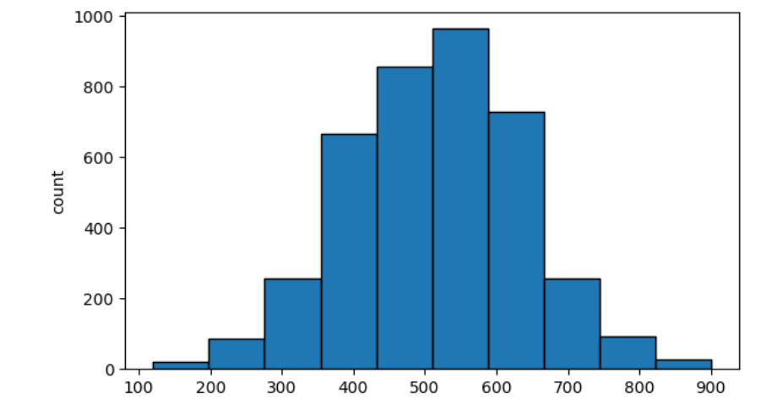
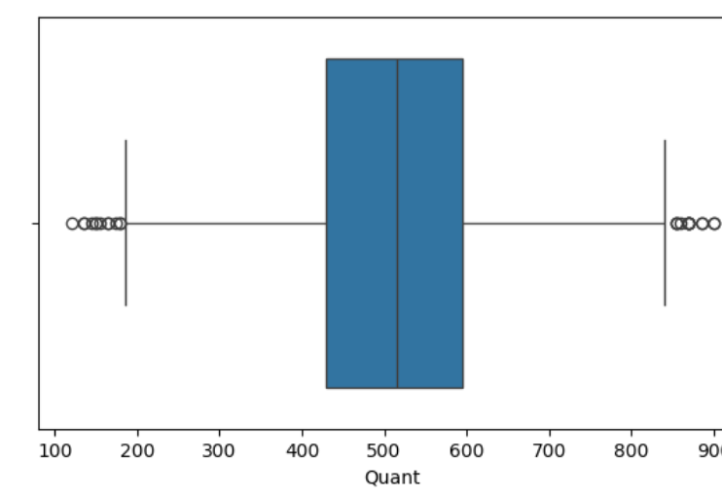
Quant
min: 120 max: 900 mean: 513.31 median: 515.0 25%: 430.0 50%: 515.0 75%: 595.0 skew: -0.02 kurtosis: -0.09
Average Performance:
The average score was 513.
Outliers Present:
Both very low and very high scores were present, as shown by the box plot.

Slide 14
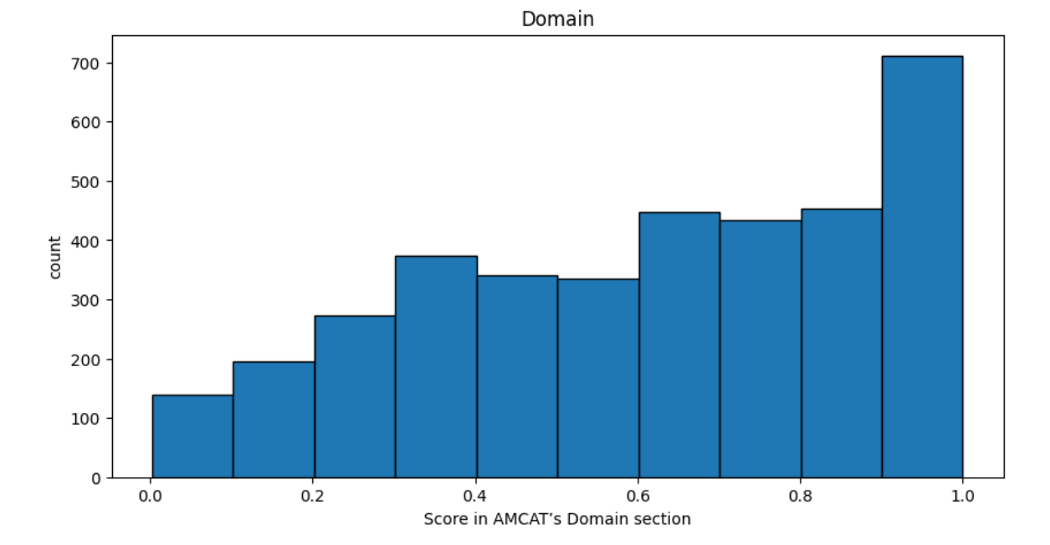
Domain
count 3701.000000 mean 0.610209 std 0.273295 min 0.002750 25% 0.376060 50% 0.649390 75% 0.842248 max 0.999910 skew: -0.39 kurtosis: -0.96
Nearly 94% of the students appeared for Domain Test.

Slide 15
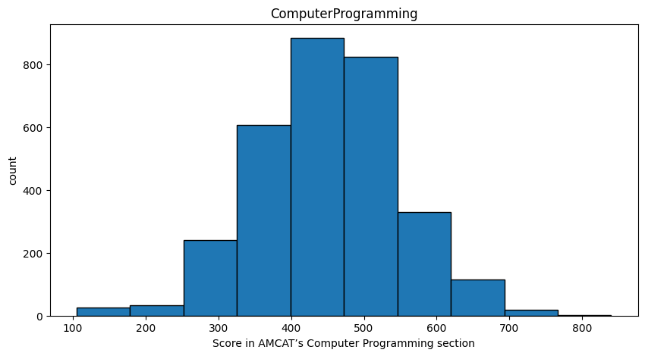
Computer Programming
count 3082.000000 mean 451.736859 std 97.358774 min 105.000000 25% 385.000000 50% 455.000000 75% 515.000000 max 840.000000 skew: -0.03 kurtosis: 0.4
Nearly 78% of the students appeared for Computer Programming Test

Slide 16
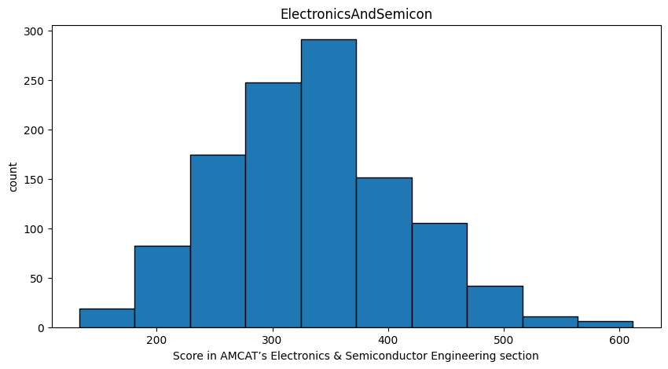
Electronics and Semiconductor Engineering
count 1128.000000 mean 335.902482 std 81.474016 min 133.000000 25% 292.000000 50% 333.000000 75% 388.000000 max 612.000000 skew: 0.28 kurtosis: -0.03
Nearly 28% of the students appeared for Electronics and SemiconductorTest

Slide 17
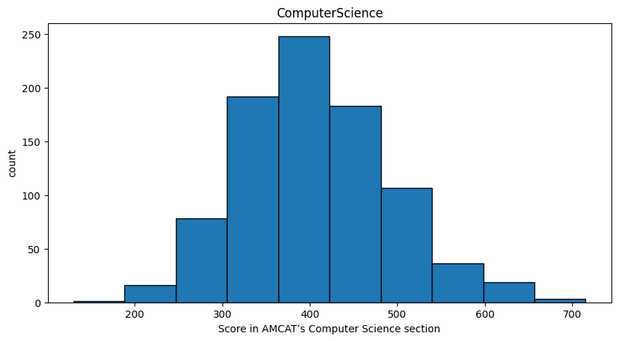
Computer Science
count 883.000000 mean 405.740657 std 90.072241 min 130.000000 25% 346.000000 50% 407.000000 75% 469.000000 max 715.000000 skew: 0.39 kurtosis: 0.21
Nearly 22% of the students appeared for Computer Science Test

Slide 18
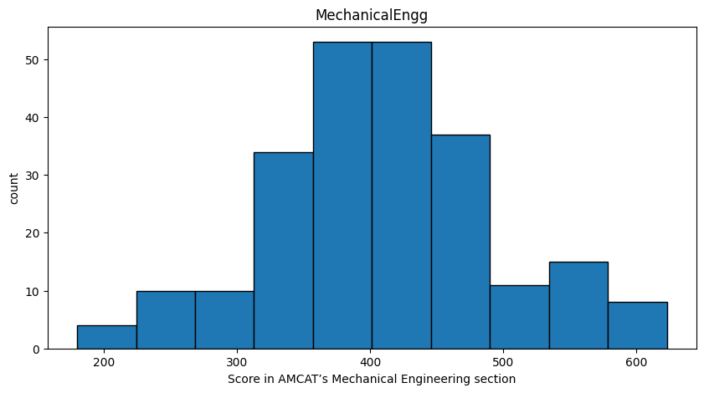
Mechanical Engineering
count 235.000000 mean 406.876596 std 84.894993 min 180.000000 25% 362.000000 50% 407.000000 75% 446.000000 max 623.000000 skew: 0.15 kurtosis: 0.05
Nearly 6% of the students appeared for Mechanical EngineeringTest

Slide 19
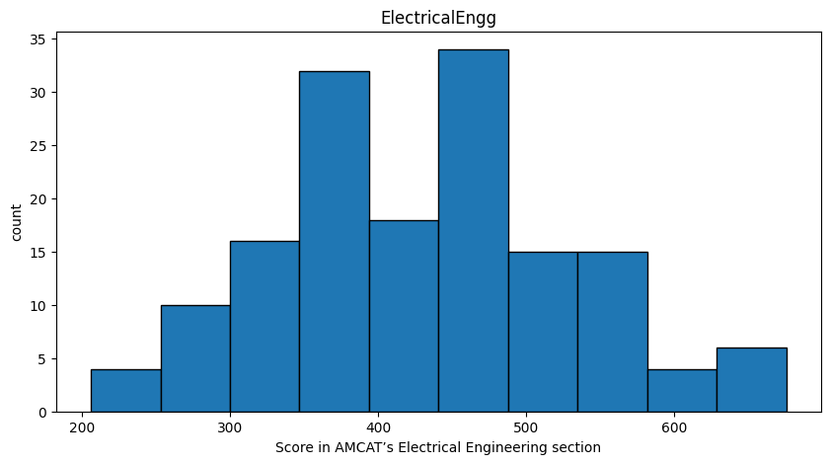
Electrical Engineering
count 154.000000 mean 431.701299 std 99.732789 min 206.000000 25% 366.000000 50% 420.000000 75% 500.000000 max 676.000000 skew: 0.2 kurtosis: -0.29
Nearly 4% of the students appeared for Electrical EngineeringTest

Slide 20
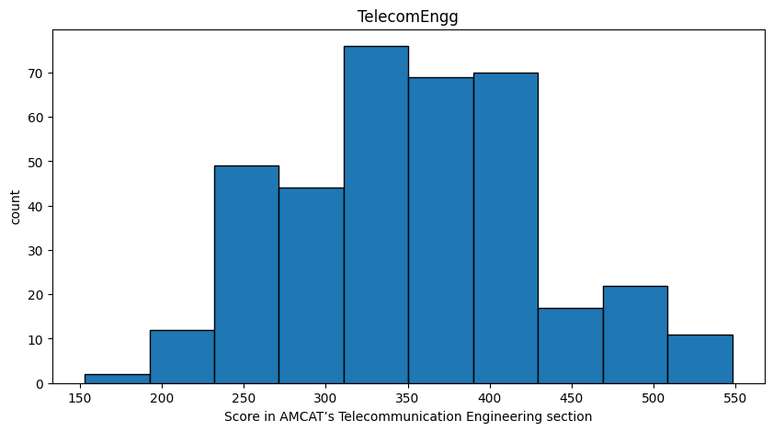
Telecommunication Engineering
count 372.000000 mean 350.158602 std 75.808377 min 153.000000 25% 286.000000 50% 356.000000 75% 393.000000 max 548.000000 skew: 0.2 kurtosis: -0.29
Nearly 9.4% of the students appeared for Tele-Communication EngineeringTest

Slide 21
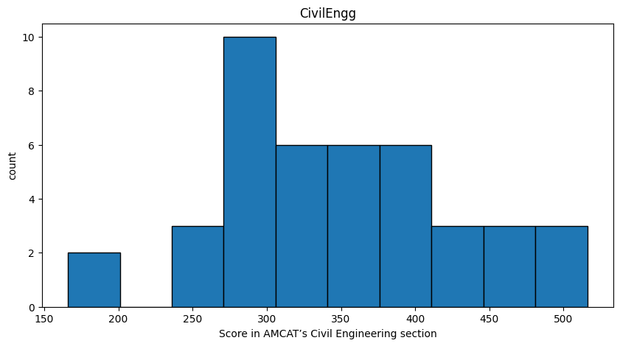
Civil Engineering
count 42.000000 mean 349.666667 std 79.784670 min 166.000000 25% 292.000000 50% 348.000000 75% 388.000000 max 516.000000 skew: 0.21 kurtosis: -0.13
Nearly 1% of the students appeared for Civil EngineeringTest

Slide 22
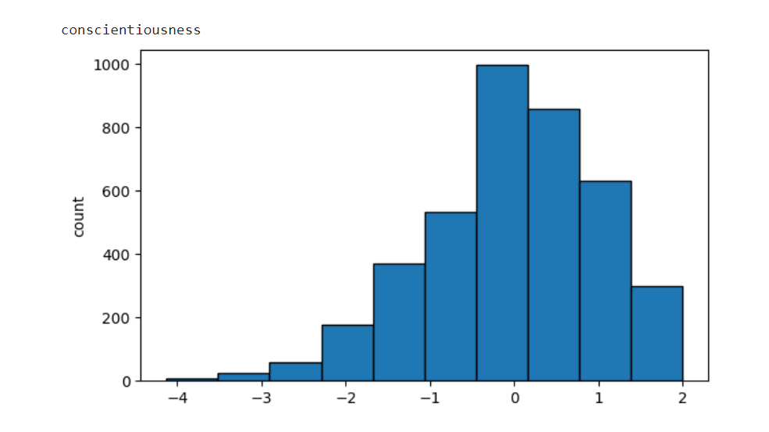
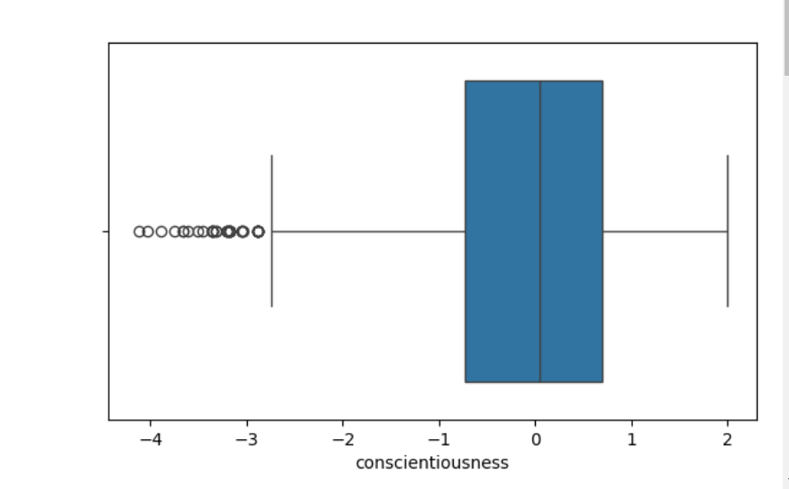
Conscientiousness
min: -4.1267 max: 1.9953 mean: -0.04 median: 0.0464 25%: -0.7264 50%: 0.0464 75%: 0.7027 skew: -0.52 kurtosis: 0.11
This trait reflects how organized, reliable, and hardworking a person is.
High conscientiousness indicates a strong work ethic and attention to detail.

Slide 23
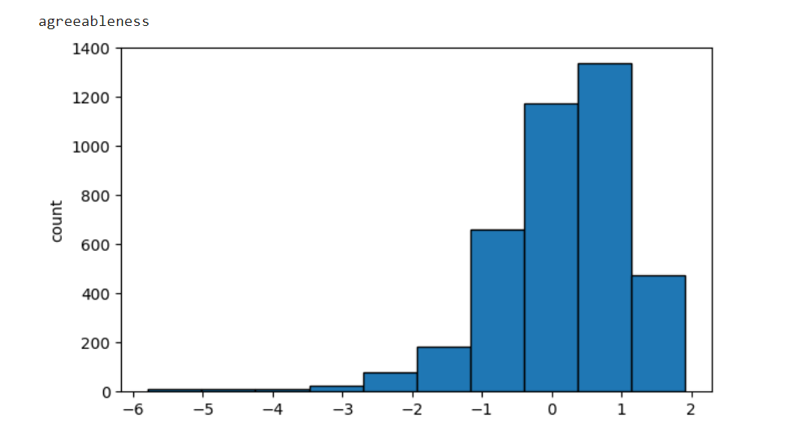
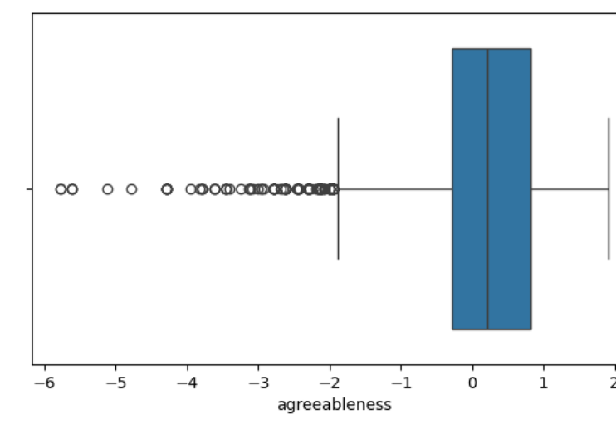
Agreeableness
min: -5.7816 max: 1.9048 mean: 0.15 median: 0.2124 25%: -0.2871 50%: 0.2124 75%: 0.8128 skew: -1.21 kurtosis: 3.44
This trait measures your tendency to be considerate, cooperative, and friendly towards others.
High Agreeableness indicates that you are empathetic and value harmony in your relationships.

Slide 24
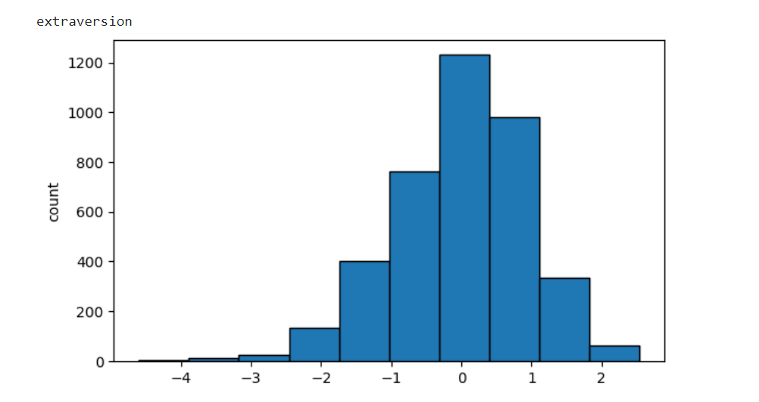
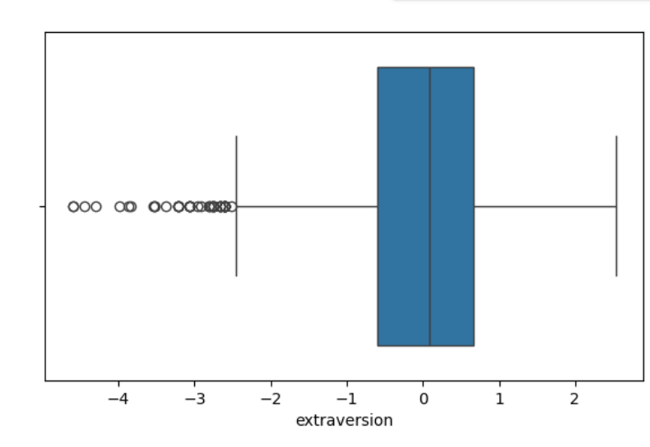
Extraversion
min: -4.6009 max: 2.5354 mean: -0.0 median: 0.0914 25%: -0.6048 50%: 0.0914 75%: 0.672 skew: -0.52 kurtosis: 0.64
This trait describes how sociable and outgoing a person is.
High extraversion is associated with a personality that is energetic, talkative, and enjoys social interactions.

Slide 25
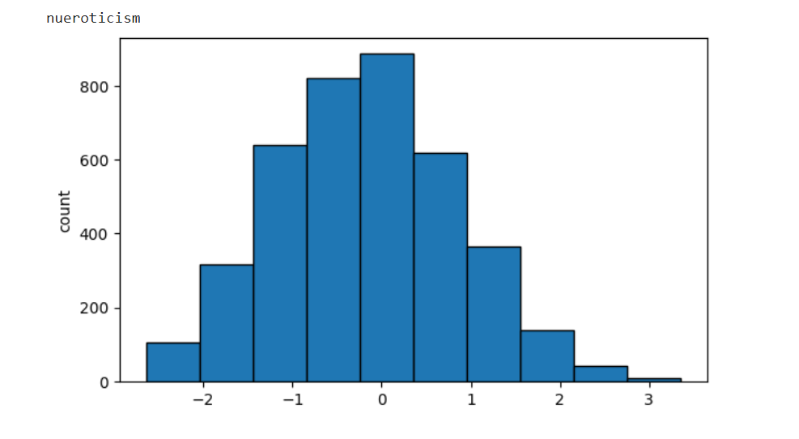
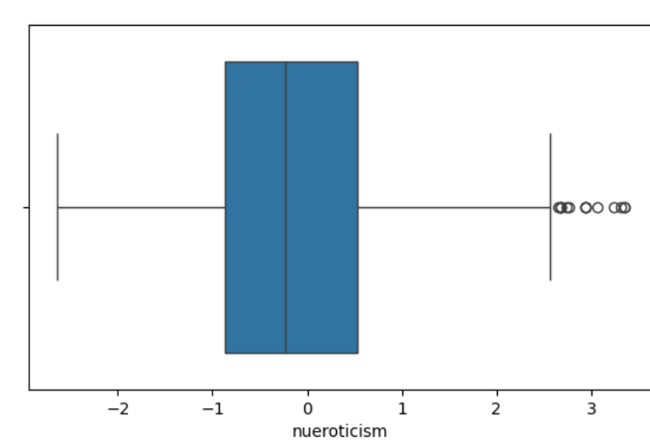
Nueroticism
min: -2.643 max: 3.3525 mean: -0.17 median: -0.2344 25%: -0.8682 50%: -0.2344 75%: 0.5262 skew: 0.17 kurtosis: -0.2
This trait is associated with emotional stability and resilience:.
high levels of neuroticism suggest a tendency to experience negative emotions such as anxiety and mood swings.

Slide 26
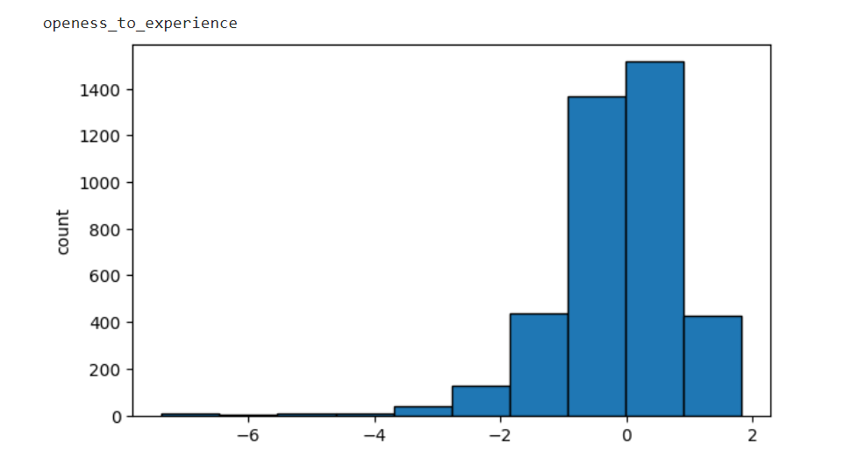
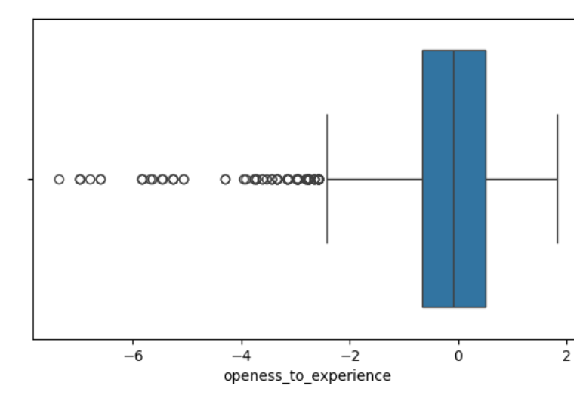
Openess_to_experience
min: -7.3757 max: 1.8224 mean: -0.14 median: -0.0943 25%: -0.6692 50%: -0.0943 75%: 0.5024 skew: -1.5 kurtosis: 5.81
This trait measures a person's willingness to engage with new ideas, experiences, and unconventional thoughts.
High openness is associated with creativity and curiosity.

Slide 27
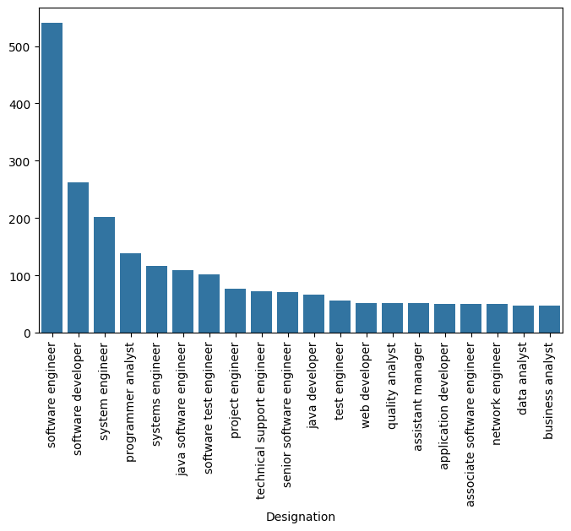
c) Univariate Analysis – Non Visual and Visual ii. For Categorical Columns
Designation
These are the Top 20 Roles among 380 different roles.
Most Popular Job Titles:
Software Engineer: This is the most frequent designation.
Software Developer: Second most frequent title.
System Engineer: Third most frequent title.

Slide 28
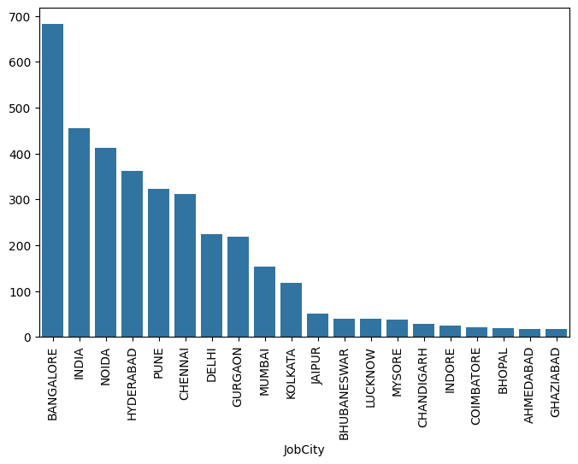
Job City
These are the Top 20 Cities among 182 different Cities.
Regarding job city preferences, Bangalore stands out as the most favorable city for job placements, followed by Noida, Hyderabad, and Pune.
In contrast, Ahmedbad and Ghaziabad are less preferred options for job seekers.

Slide 29
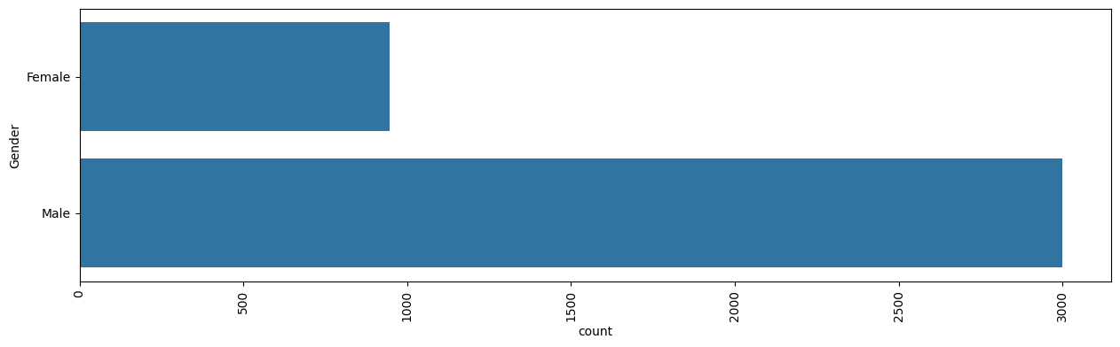
Gender
Gender distribution reveals an imbalance, with a significantly larger male population compared to females. This highlights potential gender disparities in the workforce.

Slide 30
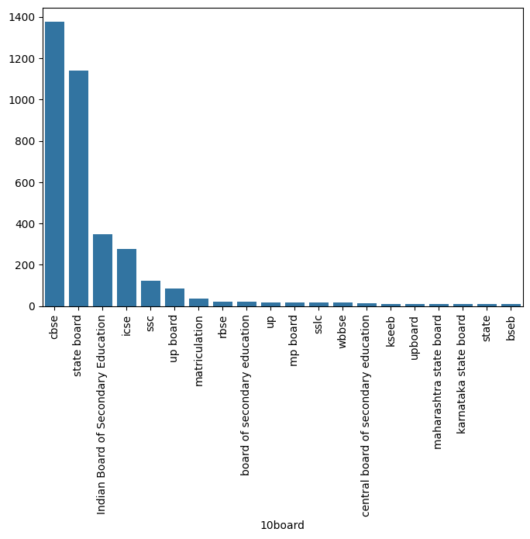
10board
These are the Top 20 10th Boards among 275 different Boards.
CBSE emerges as the most common school board for both 10th grade, indicating its widespread popularity among students.

Slide 31
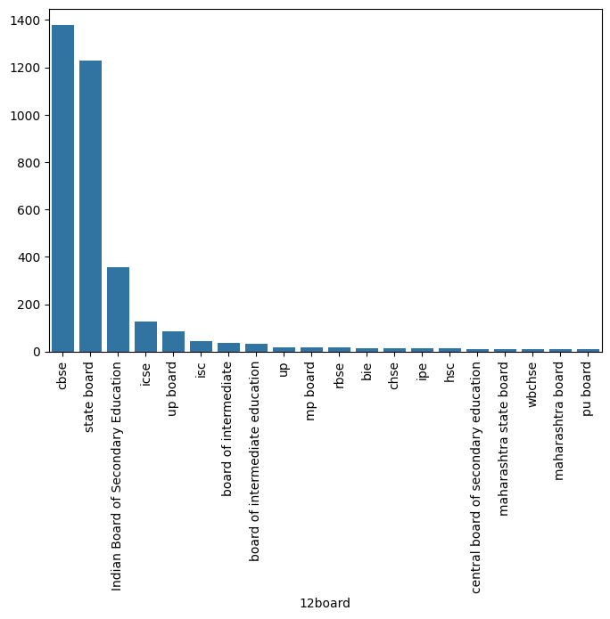
12board
These are the Top 20 12th Boards among 340 different Boards.
CBSE emerges as the most common school board for both 12th grade, indicating its widespread popularity among students.

Slide 32
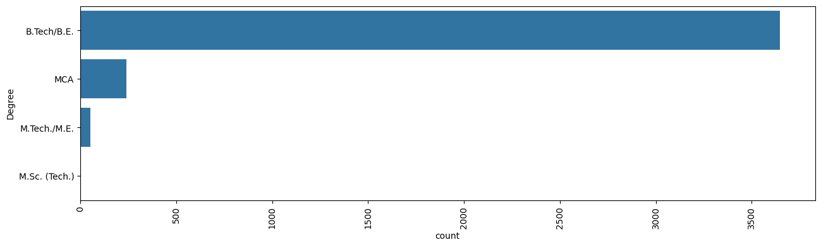
Degree
Most students have pursued a B.Tech degree, with minimal representation from M.Sc(Tech) graduates.

Slide 33
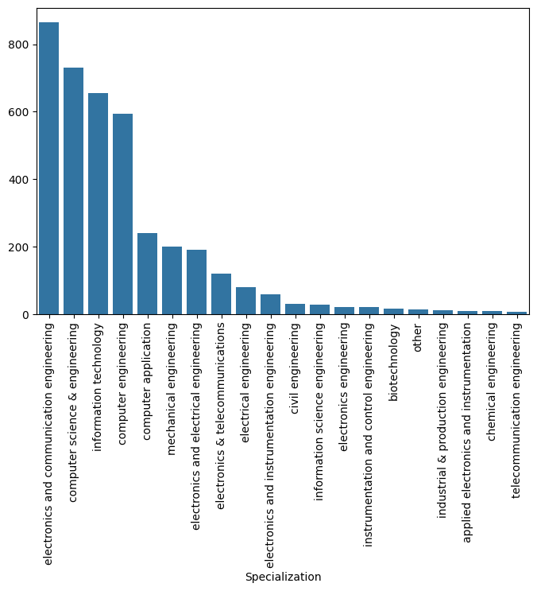
Specialization
These are the Top 20 Specialization among 44 different Specializations.
Most Popular Specializations:
Electronics and Communication Engineering This is the most frequent Specialization.
Computer Science and Engineering : Second most frequent Specialization.

Slide 34
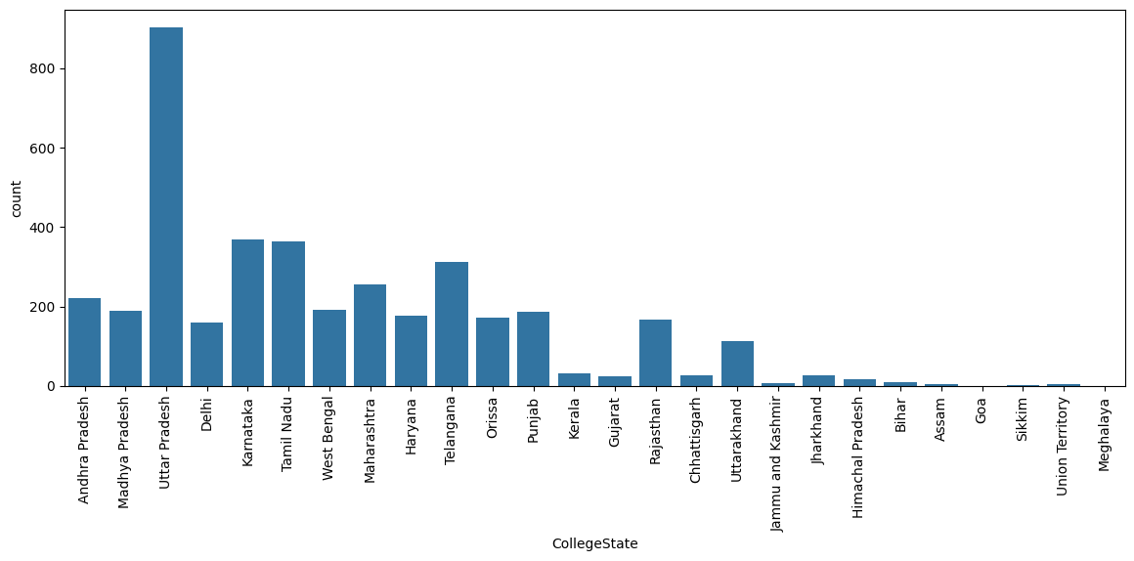
College State
The order of most common students is Uttar Pradesh followed by Karnataka and Tamil Nadu.

Slide 35
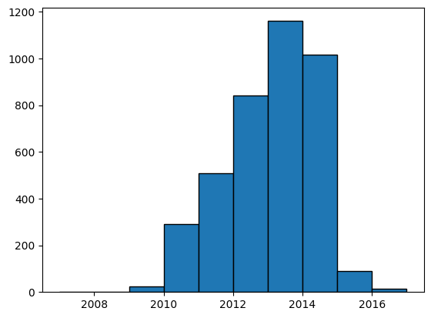
Graduation Year
Maximum number of students were graduated in 2013, followed by the year 2014 and 2012.

Slide 36
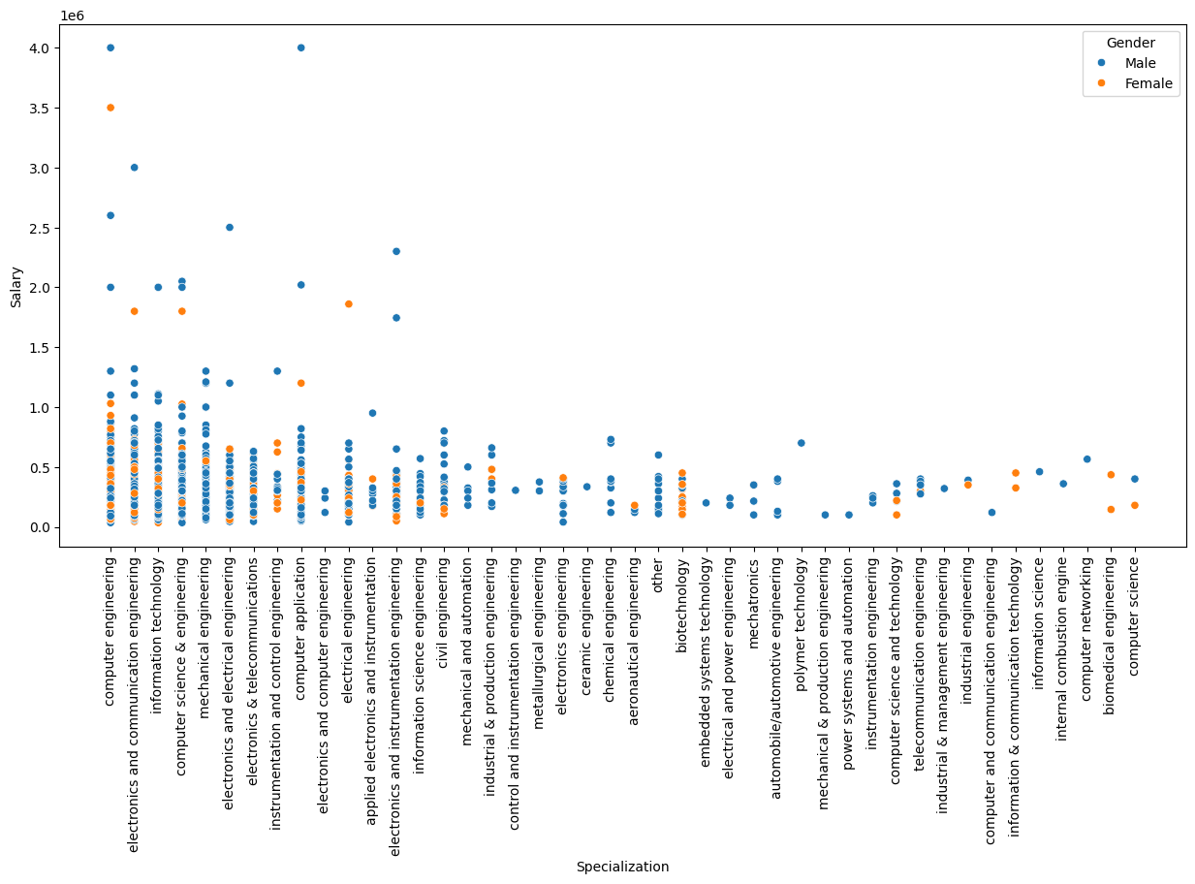
d) Bivariate Analysis – Non Visual and Visual
Scatterplot on Specialization,Salary comparing the Gender
This scatter plot tells about the specialization and salary of the employee's and Gender how many employee's are from male and the how many employee's are from female

Slide 37
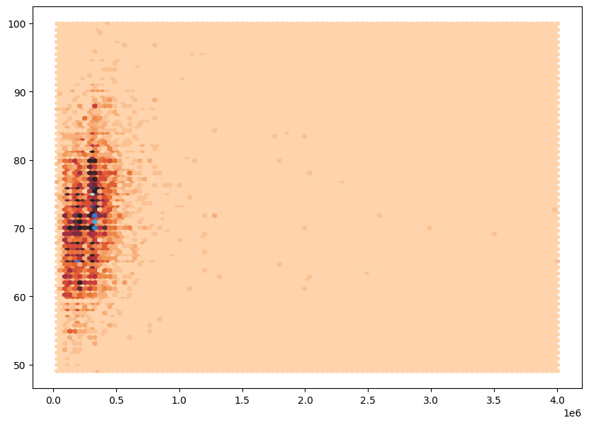
Hexbinplot on Salary,collegeGPA

Slide 38
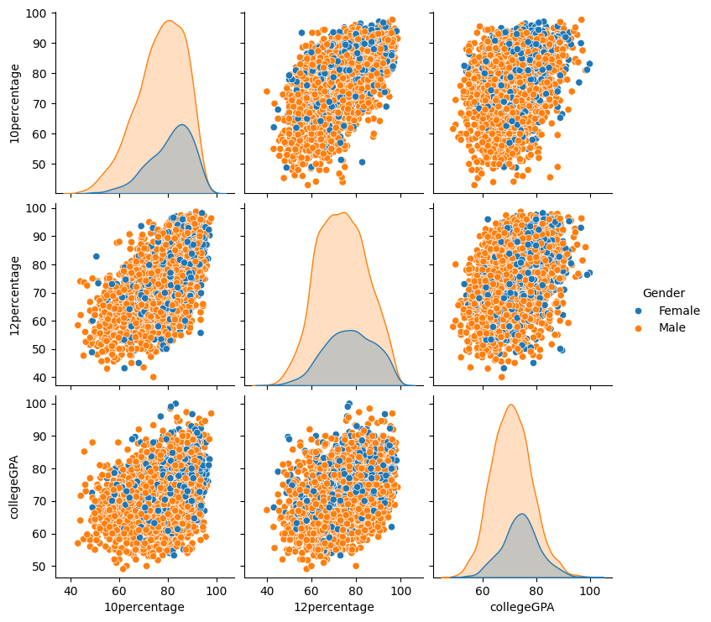
This pair plot tells about the all the employee's percentages and it shows the difference of male and female.

Slide 39
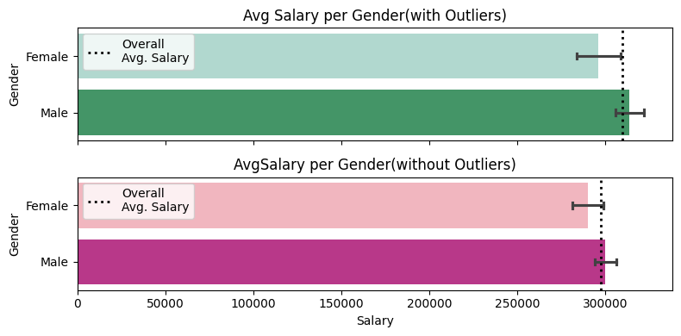
Average Salary for every Gender
Similar Overall Averages: The data shows similar average salaries for men and women, suggesting no immediate gender bias in this regard.

Slide 40
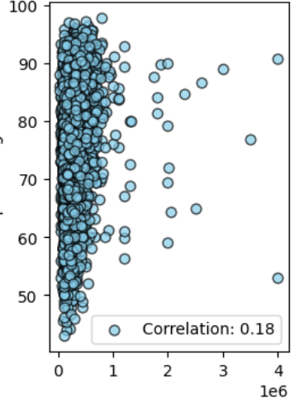
Salary & 10th Score
The data shows no link between performance in 10th grade and future salary.

Slide 41
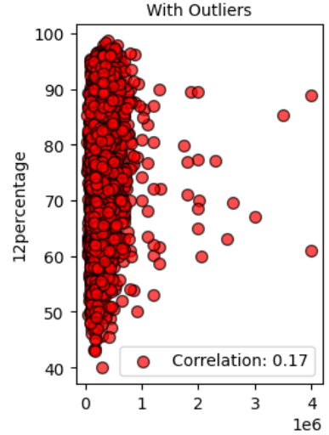
Salary & 12th score
Getting good grades in 12th grade doesn't guarantee a higher salary later on.

Slide 42
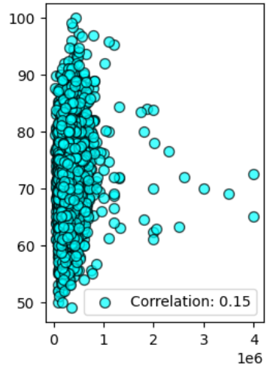
Salary and CollegeGPA
Doing well in college doesn't guarantee a higher salary later in life.

Slide 43
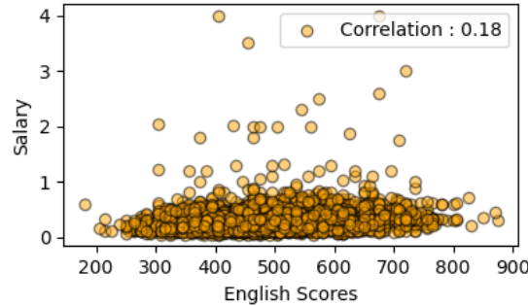
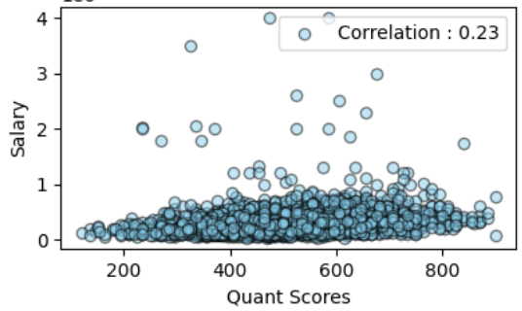
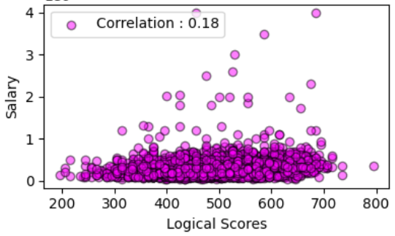
Salary with including English, Quants, Logical
The scatter plots suggest that the scores don't have a direct impact on salary.

Slide 44

Average Salary per JobCity
It shows a average salary received in different city.
Mumbai shows to have higher average salary and lucknow has the lowest salry.

Slide 45

Average Salary per CollegeTier
Tier 1 Colleges Lead in Salary
Colleges from Tier 1 cities: Graduates tend to earn higher salaries compared to those from Tier 2 cities.
Tier 2 Colleges: Salaries offered are generally below the overall average.

Slide 46

Average Salary per CollegeCityTier
When it comes to salary, there's little difference between Tier 1 and Tier 2 cities for students.

Slide 47
Some Imp Key Insights
Even though many have done B.Tech/B.E but the candidates who have done M.Tech generally receives higher salary.
Software Engineer has higher salaries even with average salaries exceeding 500,000.
Examining the gender distribution across different specializations reveals that male participation is approximately double that of females across all specializations. Additionally, fewer females opt for mechanical and electronics specializations compared to males. This gender disparity in specialization choices highlights potential gender-related factors influencing career paths and choices among individuals in the dataset.
While some Senior Software Engineers earn considerably high salaries, there is also significant variability in their compensation. On the other hand, Software Developers and Technical Support Engineers tend to have salaries below the average, suggesting differing salary ranges based on job titles within the dataset.
While factors such as tenure and college tier have a notable influence on salary, others such as gender and academic scores show little to no correlation with salary outcomes. Outliers in age were removed, suggesting that age alone does not dictate salary levels. These observations underscore the complex interplay of various factors influencing salary outcomes in the context of the dataset.

Slide 48
RESEARCH OUTCOMES
A "Times of India" article dated Jan 18, 2019, states that "After doing your Computer Science Engineering if you take up jobs as a Programming Analyst, Software Engineer, Hardware Engineer, and Associate Engineer you can earn up to 2.5-3 lakhs as a fresh graduate."
This claim can be tested using the dataset to assess the salary levels of fresh graduates in these specific job roles and determine if they align with the salary range mentioned in the article.
The analysis begins by grouping the dataset by job designation, calculating the mean and standard deviation of salaries for each job role. This provides insights into salary distribution across different designations. Notably, Software Engineers have the highest mean salary and standard deviation, indicating both higher earnings and variability in pay compared to Programmer Analysts and Associate Engineers.
Following this, a one-sample t-test is conducted for each job designation to compare their average salary against an expected range. For Programmer Analysts and Software Engineers, the test results show sufficient evidence to reject the null hypothesis, suggesting that their salaries significantly differ from the expected range. However, for Hardware Engineers and Associate Engineers, there is not enough evidence to reject the null hypothesis, indicating that their salaries may not significantly deviate from the expected range.

Slide 49
Overall, these analyses provide valuable insights into salary distributions among different job roles and help in understanding the significance of salary differences within the dataset.
Is there a relationship between gender and specialization? (i.e. Does the preference of Specialization depend on the Gender?)
Test Value:
chi2_critical: 16.918977604620448
chi2_statistic: 48.62141720904882
chi2_p_value: 1.9542895953348e-07
The analysis conducted using a ChiSquare test examined the relationship between gender and specialization preferences. The test revealed a statistically significant relationship between the two variables, indicating that specialization preferences are dependent on gender.
The calculated chi2 statistic exceeded the critical value, and the p-value was significantly less than the chosen significance level, leading to the rejection of the null hypothesis. Therefore, there is sufficient evidence to conclude that gender and specialization are related, suggesting that certain fields may be more preferred or accessible to individuals of particular genders.
This finding underscores the importance of considering gender diversity and inclusivity in various fields and highlights potential barriers or biases that may exist in certain specializations.

Slide 50
Conclusion
A comprehensive analysis of the dataset reveals several key findings regarding the factors that influence an individual's salary level: Some criteria, such as seniority and educational attainment, show a strong correlation with compensation, while others, especially gender and educational achievement, show a weak correlation or even no correlation at all.
Senior Software Engineers emerge as the top earners within the dataset, commanding the highest incomes.
However, it is noted that their salaries also display greater variability, indicating a higher degree of unpredictability in compensation compared to other job roles.
On the contrary, software developers and technical support engineers, as a rule, earn a salary below average, assuming various wages depending on the names of the tasks as part of the data set.
It seems that the gender has no significant impact on the determination of income on average, as evidenced by similar average wages for both sexes. However, women's salaries tend to be slightly lower than average, highlighting a potential gender pay gap.
Academic achievement, as measured by 10th grade, 12th grade, and college GPA scores, doesn't show a clear correlation with salary levels.
This suggests that factors other than academic achievement play a larger role in determining the earnings outcomes of individuals in the dataset.
In conclusion, factors such as years of experience and level of university show strong relationships with salary levels, while other factors such as gender and education level show weaker relationships. These results highlight the complexity of factors influencing compensation outcomes across datasets and underscore the need for a detailed understanding of the different determinants of compensation.

Slide 51

Q&A
Please feel free to ask your Questions.
Here’s my LinkedIn Profile

Slide 52

THANK YOU

